Slide 1
Module 11

Slide 2
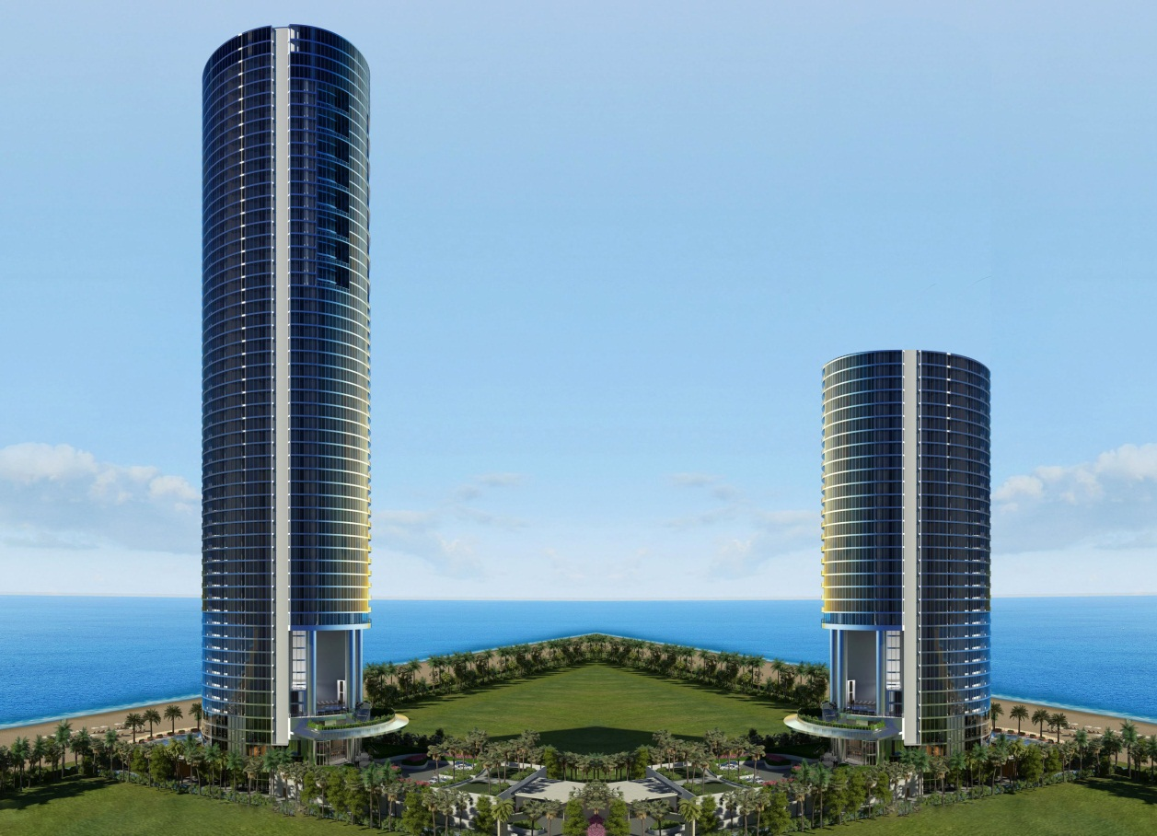
Q. The angle of elevation of the top of a building from the foot of
the tower is 30º and the angle of elevation of the top of tower from
the foot of the building is 60º. If the tower is 30m high,
find the height of the building ?
A
Top of the
Tower
Tower
Top of the
building
Building
line of sight
D
30m
line of sight
?
Foot of the
building
Foot of the
tower
B
30º
60º
C
Observer
Observer

Slide 3

Q. The angle of elevation of the top of a building
from the foot of the tower is 30º and the angle of
elevation of the top of tower from the foot of the
building is 60º. If the tower is 30m high, find the
height of the building ?
Now, let us rationalise the denominator
A
Ratio of opposite side and Adjacent side reminds us of _________
For ∠ACB
Consider ΔABC
Observe ∠ACB
Opposite side →
AB
‘tan’
Opposite
side
Adjacent side →
BC
30m
Sol.
AB represents the height of the tower.
D
AB = 30m
CD represents the height of the building.
?
30º
60º
∠DBC = 30º
B
C
∠ACB = 60º
$$\sqrt{3}$$
tan 60º =
?
30
In right angled ΔABC,
×
3
Adjacent side
∴
BC
=
3
3
tan 60º =
AB
BC
10
30
3
30
∴
BC
=
∴
3
=
3
BC
30
∴
BC
=
10
3
m
∴
BC
=
3

Slide 4

Q. The angle of elevation of the top of a building
from the foot of the tower is 30º and the angle of
elevation of the top of tower from the foot of the
building is 60º. If the tower is 30m high, find the
height of the building ?
A
Consider ΔDBC
Observe ∠DBC
For ∠DBC
Ratio of opposite side and Adjacent side reminds us of _________
1
Opposite side →
DC
tan 30º =
?
‘tan’
Opposite
side
$$\sqrt{3}$$
Adjacent side →
BC
30m
Sol.
BC
=
10
m
3
D
In right angled ΔDBC,
DC
?
tan 30º =
30º
60º
BC
B
C
10
3
1
DC
Adjacent side
∴
=
3
10
3
10
3
∴
DC
=
3
∴
DC
=
10 m
Height of the building is 10m

Slide 5
Module 12

Slide 6
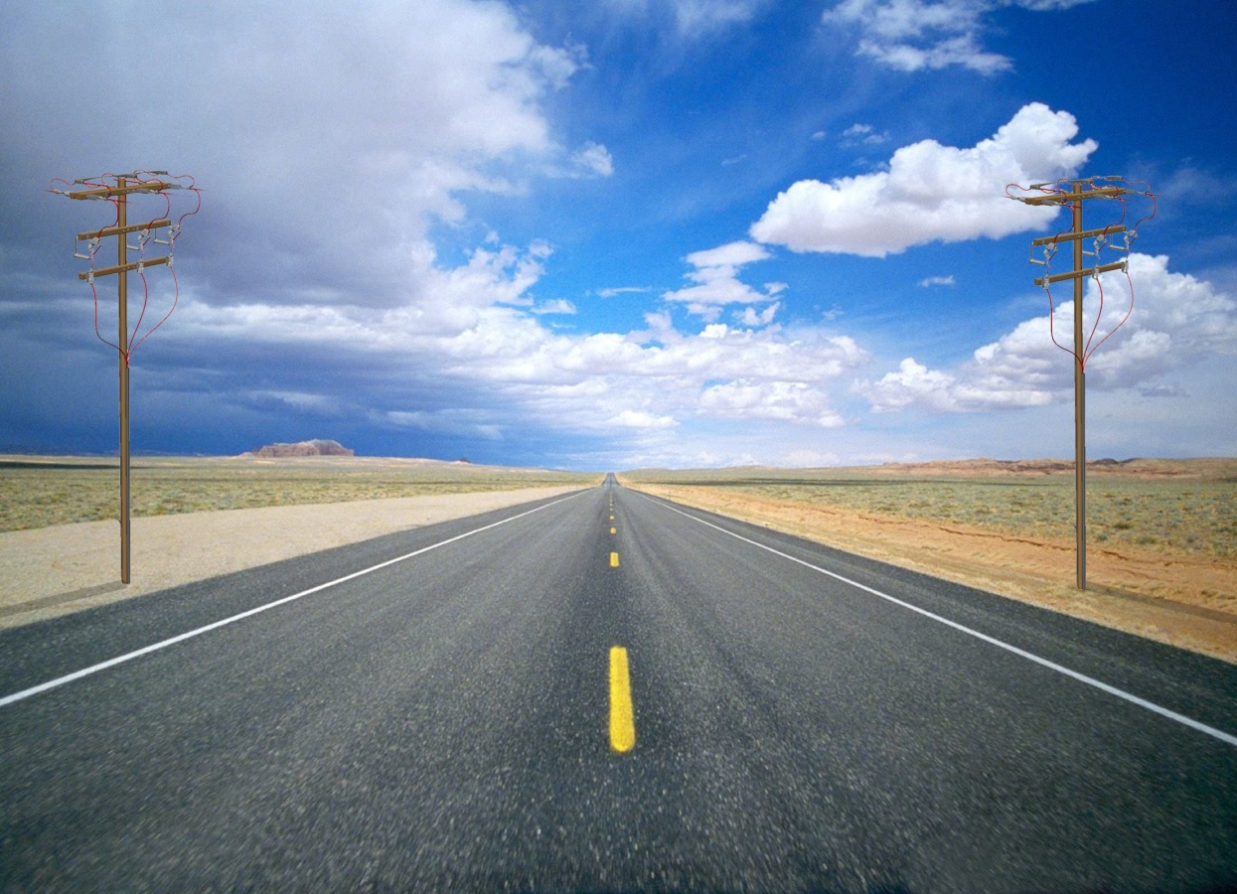


Q. Two poles of equal heights are standing opposite each other on
either side of the road, which is 80 m wide. From a point between
them on the road, the angles of elevation of the top of the poles
are 60° and 30° respectively. Find the height of the poles and the
distances of the point from the poles.
Height of the observer is neglected
B
D
line of sight
line of sight
?
?
30º
60º
A
C
?
E
?
80m

Slide 7

Two poles of equal heights are standing
opposite each other on either side of the
road, which is 80 m wide. From a point
between them on the road, the angles of
elevation of the top of the poles are 60°
and 30° respectively. Find the height of
the poles and the distances of the point
from the poles.
B
Opposite
side
D
Ratio of opposite side and Adjacent side reminds us of _________
Consider ΔBAE
For ∠AEB
Observe ∠E
Let us find EC
h
h
Opposite side →
AB
‘tan’
Adjacent side →
AE
30º
60º
A
E
80 – x
C
x
Sol.
Let the height of poles be ‘h’ m
80
Adjacent side
Width of the road (AC) = 80 m
Let the distance of the point E
from pole AB i.e AE be ‘x’ m
AE + EC = AC
∴ x + EC = 80
∴ EC = (80 – x) m
∴
The distance of the point from
the pole CD i.e EC =
1
tan 30º =
?
(80 – x) m
$$\sqrt{3}$$
∴
1
h
In right ΔBAE,
=
3
x
AB
∴
h
tan 30º
=
x
=
3
…(i)
AE

Slide 8








Two poles of equal heights are standing
opposite each other on either side of the
road, which is 80 m wide. From a point
between them on the road, the angles of
elevation of the top of the poles are 60°
and 30° respectively. Find the height of
the poles and the distances of the point
from the poles.
B
D
Opposite
side
For ∠DEC
Consider ΔDCE
Ratio of opposite side and Adjacent side reminds us of _________
Observe ∠E
Opposite side →
CD
‘tan’
h
h
Adjacent side →
EC
30º
60º
$$\sqrt{3}$$
tan 60º =
?
A
C
x
E
80 – x
Sol.
In right ΔDCE,
x
=
3
h
…(i)
80m
Adjacent side
CD
tan 60º
=
EC
∴
h
3
=
20
80 – x
80$\sqrt{3}$
∴
$\sqrt{3}$ = 1.73
∴
(80 – x)
h
=
3
=
h
4
∴
h
=
3
(80 – $\sqrt{3}$ h)
[From (i)]
∴
h
=
20$\sqrt{3}$
80$\sqrt{3}$
–
∴
h
=
3h
=
20
× 1.73
∴
h
+ 3h
=
80$\sqrt{3}$
=
34.6m
∴
4h
=
80$\sqrt{3}$

Slide 9




Two poles of equal heights are standing
opposite each other on either side of the
road, which is 80 m wide. From a point
between them on the road, the angles of
elevation of the top of the poles are 60°
and 30° respectively. Find the height of
the poles and the distances of the point
from the poles.
B
D
34.6m
34.6m
30º
60º
A
E
80 – x
C
x
Sol.
$\sqrt{3}$ h
x
=
h
…(i)
80m
AE
=
x
=
3
=
$$\sqrt{3}$$
× 20$\sqrt{3}$
h
=
2$0\sqrt{3}$
=
20
× 3
x
=
60
EC
=
80 – x
=
80
– 60
=
20m
∴
Height of the poles are 34.6 m each
Distance of the point from pole AB is 60 m and
Distance of the point from pole CD is 20 m

Slide 10
Module 13

Slide 11
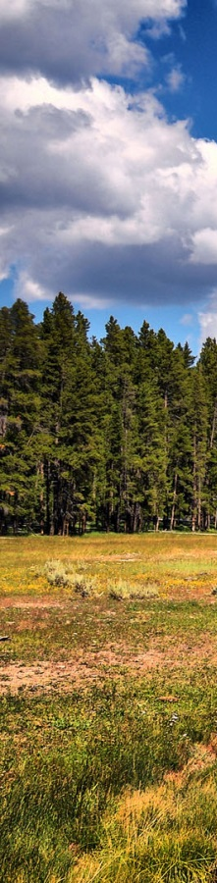


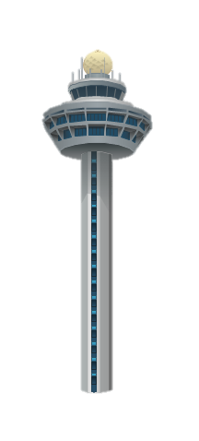

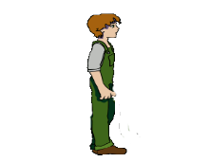

Q. A TV tower stands vertically on a bank of a canal. From a point on the
other bank directly opposite the tower, the angle of elevation of the top
of the tower is 60°. From another point 20 m away from this point on the
line joining this point to the foot of the tower, the angle of elevation of the top
of the tower is 30º. Find the height of the tower and the width of the canal.
A
Height of the observer is neglected
line of sight
observer
?
line of sight
30º
60º
?
D
B
20 m
C

Slide 12



A TV tower stands vertically on a bank of a canal.
From a point on the other bank directly opposite
the tower, the angle of elevation of the top of the
tower is 60°. From another point 20 m away from
this point on the line joining this point to the foot
of the tower, the angle of elevation of the top of
the tower is 30º. Find the height of the tower and
the width of the canal.
Opposite
side
A
For ∠ACB
Ratio of opposite side and Adjacent side reminds us of _________
Observe ∠C
Consider ΔABC
Opposite side →
AB
‘tan’
h
Adjacent side →
BC
30º
60º
D
20 m
C
B
Sol.
Let the height of tower be ‘h’ m
x
Let the width of the canal be ‘x’ m
Adjacent side
$$\sqrt{3}$$
Distance (DC) = 20 m
tan 60º =
?
In right ΔABC,
AB
tan 60º
=
BC
h
∴
$$\sqrt{3}$$
=
x
∴
h
=
$\sqrt{3}$ x

Slide 13










A TV tower stands vertically on a bank of a canal.
From a point on the other bank directly opposite
the tower, the angle of elevation of the top of the
tower is 60°. From another point 20 m away from
this point on the line joining this point to the foot
of the tower, the angle of elevation of the top of
the tower is 30º. Find the height of the tower and
the width of the canal.
h
$$\sqrt{3}$$
A
=
x
Ratio of opposite side and Adjacent side reminds us of _________
For ∠ADB
Opposite
side
Observe ∠D
Consider ΔABD
Opposite side →
AB
‘tan’
h
Adjacent side →
BD
1
30º
60º
tan 30º =
?
D
C
B
$$\sqrt{3}$$
20 m
10 m
Sol.
In right ΔABD,
x
$$\sqrt{3}$$
(x + 20)
AB
h
=
x
Adjacent side
tan 30º
=
$\sqrt{3}$ = 1.73
BD
$$\sqrt{3}$$
1
h
=
× 10
∴
=
$$\sqrt{3}$$
x + 20
$$\sqrt{3}$$
h
=
10
$$\sqrt{3}$$
∴
x + 20
=
h
10
$$\sqrt{3}$$
$$\sqrt{3}$$
h
=
×
1.73
= 17.3
∴
x + 20
=
x
×
∴
x + 20
=
3x
Width of the canal is 10 m
and Height of the tower is 17.3 m
∴
20
=
2x
∴
x
=
10

Slide 14
Module 14 Solved Example 5

Slide 15
Thank You

